Slide 1

Task: Squircle Task
In this task you will be presented with 8 circles in varying red and blue colors
We would like to ask you to choose whether the average circle color is more blue or more red.
Please, try to be as fast as possible while trying to give correct answers.
First block you will receive feedback as follows: Wrong or Correct
Spacebar
Press in order to continue
Notes:
1

Slide 2
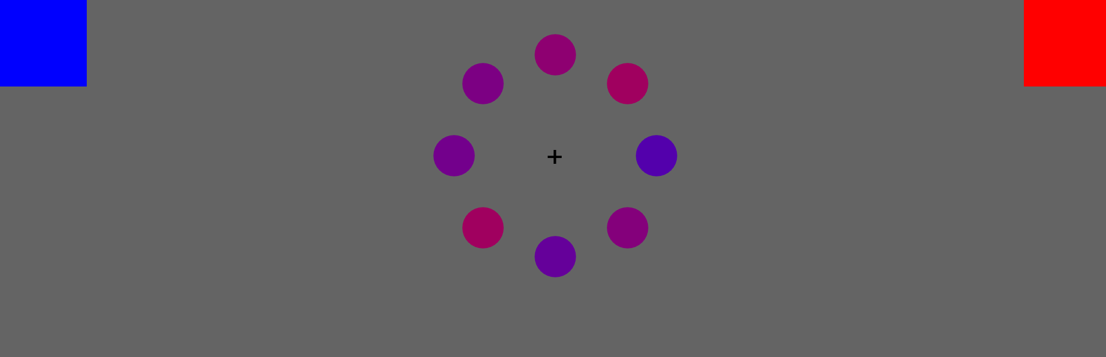
Task: Squircle Task
You will see the stimuli for a brief time, you will make your decision by moving your cursor to either the blue or the red box.
You do not need to click on the box after you move your cursor
After you choose the color, move the cursor back to the box at the lower center of the screen.
In the next page you will see a short clip of how you should be responding to the stimulus.
After you familiarize yourself with the trial procedure you can press spacebar to start with the training block.
Press the above-mentioned keys to respond:
First 40 trial will have feedback on the correctness of the given answer.
This procedure should take around XX – XX minutes.
You can click on “spacebar” whenever you are ready, and the procedure will begin.
Spacebar
Press in order to continue
Press to in order to continue
Notes:
1

Slide 3
Break Time!
Break :
Out of 9 breaks
Your Cumulative Average Accuracy
Your Cumulative Average Reaction Time
Press to in order to continue

Slide 4
Whenever you are ready
You can start the Experiment
Good luck ☺
Press to in order to continue

Slide 5
This task has been completed and finished successfully.
Everything is now finished.
Assistant will inform you with details.
Thank you for your participation!
Press to in order to exit

